Slide 1



Understanding sex differences in autism, Part I:
Recent advances in autism genetics and what this research tells us about risk
Donna M. Werling
Geschwind Laboratory, UCLA
October 18, 2014
Session 2B

Slide 2
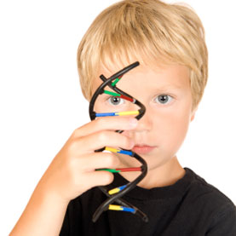


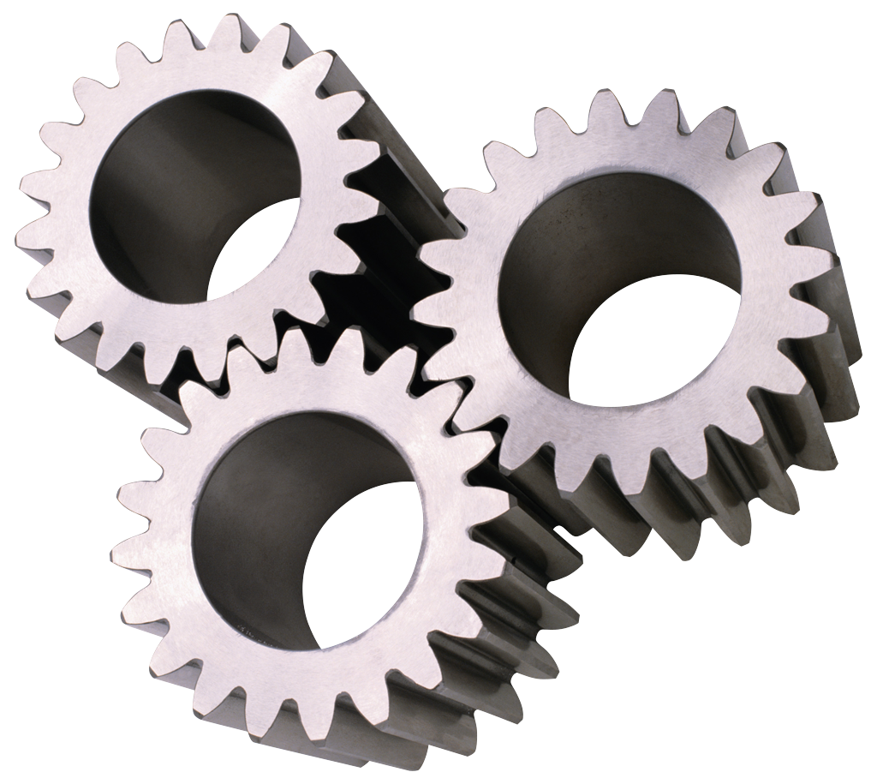
Outline
Recent advances in autism genetics research
http://www.scientificamerican.com/article/autism-genetic-mutations/
What genetics & family data show us about risk to females vs. males
Proposed mechanisms for females’ protection, males’ risk
Notes:
2 talks in 1

Slide 3
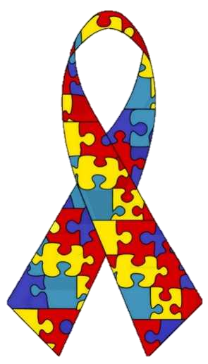
Recent advances in autism genetics
How do we know that genetic variation contributes to risk for autism?
  Twins
Concordance:
~50-95%, MZ
~10-36%, DZ
  Siblings
Recurrence: ~10-20%
  Syndromes
Fragile X Syndrome
Autism spectrum disorders
Rett Syndrome
Tuberous Sclerosis
Joubert Syndrome
Notes:
Risk to siblings is 10-15x higher than general population
Monogenic syndromes (meaning we know the gene/mutation that causes them) show symptom overlap with ASD

Slide 4
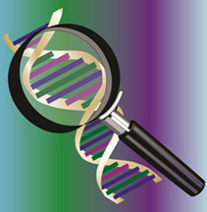



Recent advances in autism genetics
Gene discovery
* Exome sequencing
* Genome sequencing
Biological mechanisms
http://www.ars.usda.gov/is/pr/2010/100920.htm
Genetic architecture
Do risk genotypes affect the same pathways?
How do these pathways → autistic brain?
Monogenic ASD subtypes
Which genotypes “build” a population of autistic individuals?
Genetic variants at one site → Autistic traits
* Co-expression of risk genes in developing human brain
* ASD’s overlap with other psychiatric conditions
* CHD8 mutations
* 2-class family risk model
Brain by _DJ_ via Creative Commons http://www.flickr.com/photos/flamephoenix1991
http://www.microscopyview.com/
http://www.blueprint22.org.uk/
Notes:
Recent advances fall into several main areas of research
Complementary approaches
- Gene discovery = looking for genes with risk-increasing mutations. Window into the biological processes gone awry
- Biological mechanisms = Once we have discovered enough genes, can begin probing mechanisms.
- Molecules and cells act together in coherent groups to perform specific functions, how to get from genes to brain/behavior?
- Monogenic ASD subtypes = "splitting" approach, discovered genes allow us to define "the autisms"
- Genetic architecture = abstract, but important to know how a condition comes to affect a population
Mech'ms/common pathways, or monogenic subtypes are great starting points for Rx development
Genetic architecture useful for family planning
Mech'ms and architecture can inform the best design for further gene discovery work
Will touch on a few recent advances in each of these areas of research

Slide 5
Gene discovery:
Exome sequencing
In 2012, exome sequencing completed on 987 patients from simplex families
  Identified 8 genes with ≥2 de novo, loss-of-function variants
Iossifov, et al., Neuron, 2012; Neale, et al., Nature, 2012; O’Roak, et al., Nature, 2012; Sanders, et al., Nature, 2012
Genome
Exome
Exome sequencing continues, now in ~1,500 patients
  Identified 18 genes with ≥2 de novo, loss-of-function variants
Sanders, et al., IMFAR, 2014
Notes:
Illustrate genome - 26 letters and 10 digits here instead of the 4 nucleotide bases in DNA
Genome contains all instructions for constructing protein molecules, which perform most functions in your cells/body
Physical chain of information, only some links contain the instructive material ==> Exome, coding sequence.
De novo variant is a change to sequence that a child has, but not their parents - variant occurred in the making of a sperm or egg cell
Easy to see how mutations/variants in this exome/coding sequence could lead to production of a flawed protein
8 genes from 987 patients - looks like small return on investment, but this is still a big deal, just reflects the complexity of biology underlying autism risk
Genes with ≥2 mutations, 95% chance of being associated with ASD risk
Still to come – an analysis of inherited variants too, which inevitably play some role

Slide 6
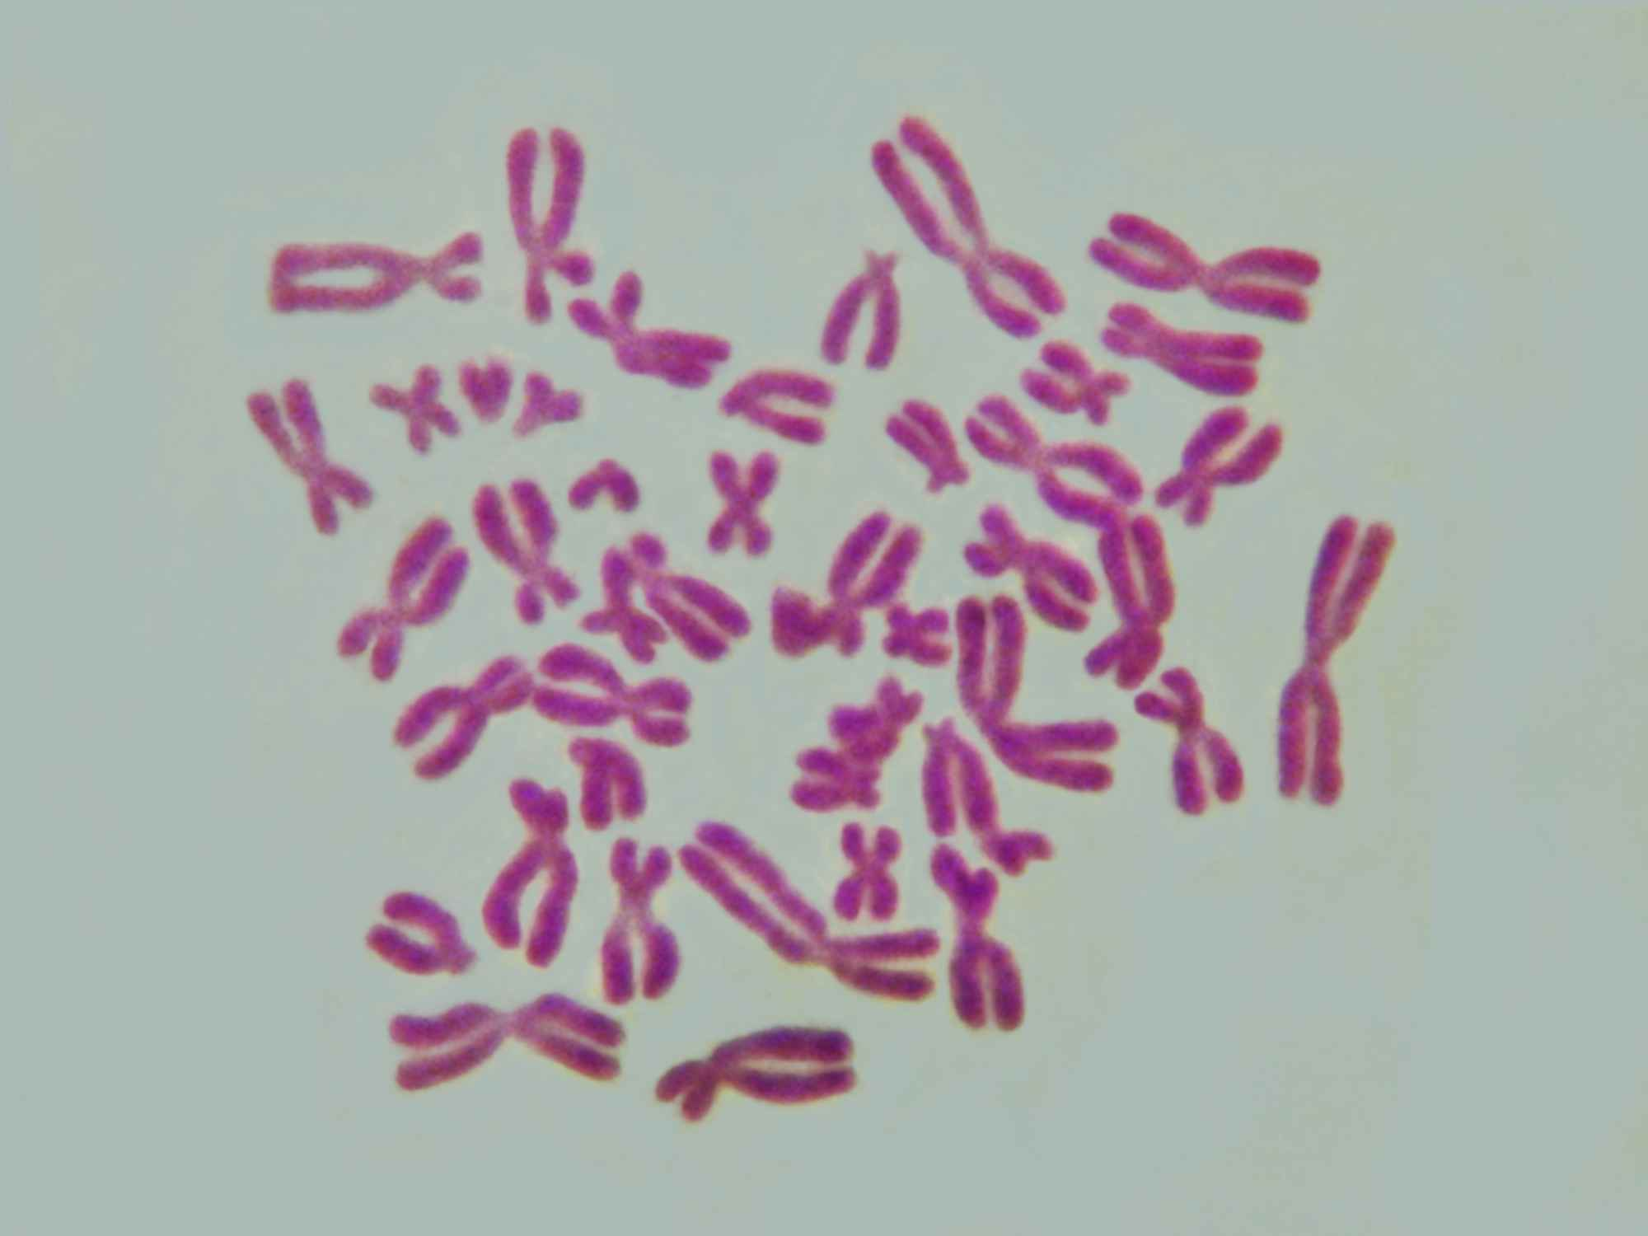
Monogenic ASD subtypes:
CHD8
CHD8 – first identified as ASD risk gene by exome sequencing
CHD8 sequencing in 3,730 patients & 8,792 controls identified 15 protein-damaging mutations
Features of mutation-carrying patients:
  ASD diagnosis (87%)
  Macrocephaly (80%)
  Gastrointestinal problems (80%)
  Facial structure abnormalities (67-78%)
  Sleep problems (67%)
  Intellectual disability (60%)
  Problems with attention (60%)
Bernier, et al., Cell, 2014
Notes:
One result to come out of exome sequencing is discovery of a new subtype of ASD, with mutations in gene CHD8
Just 15 kids, which is less than 0.5% of cases tested
But, once we understand the function of CHD8, which other genes it interacts with, etc, goal is to design treatments for kids whose autism is caused by these sets of molecules
Hope is also to find other genes that are responsible for other subtypes of ASD.

Slide 7
Gene discovery:
Genome sequencing
In 2013, whole-genome sequencing completed in 32 Canadian families
Identified “mutations of interest” in 16 families, some with clinical utility:
  Co-occurring medical conditions
  Younger siblings with mutation
Higher cost than exome sequencing, but better coverage of interpretable genomic regions
Reference exome sequence
Experimental exome sequence
Exome sequence from genome sequencing
Notes:
Exome sequencing is great - fewer base pairs, so it is cheaper, and it is part of genome that we can easily interpret, BUT genome sequencing is the way of the future
Sample too small to provide robust statistical support for any variants that they found
But, based on the functions of these genes, they are likely to be involved in risk.
Were able to return some clinically useful findings to the patients and families:
Kallman syndrome, CHARGE syndrome, (possible) symptoms of muscular dystrophy, seizures, heart arrhythmias – some families already knew, others they did not
Better coverage - what do I mean by "coverage"?
Because of the way exome sequences are captured, cannot read all parts so easily
Genome sequencing - pay more $$ to read additional base pairs, but do not lose as much information

Slide 8
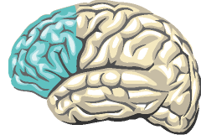
Biological mechanisms:
Gene expression in human brain
What is the function of ASD risk genes in the developing human brain?
Autism risk genes are co-expressed:
  Where?
    In prefrontal neocortex
  When?
    Mid-fetal development
Parikshak, et al., Cell, 2013; Willsey, et al., Cell, 2013
Notes:
Co-expressed = genes are turned on and off and at similar levels, together. Often correlates with coordinated function of the genes
Approach used by my colleagues at UCLA and UCSF, identify modules of co-expressed genes
Which modules do ASD risk genes belong to?
When & where do those modules show the strongest expression or activity?
Plot - M2 & M3 are the modules enriched for ASD risk genes with protein-disrupting variants
Cell types – method used to zero in on cell types involved, but not yet resolved:
- UCSF – genes enriched in layer 5/6 glutamatergic projection neurons
- UCLA – genes enriched in adult layers 2-4
Caution – not definitive, but a start (many parts of the brain were not surveyed, may also be involved)

Slide 9

Genetic architecture:
Autism shares genetics with other psychiatric conditions
Different psychiatric conditions can show overlapping symptoms
  Distinct categories may actually be a spectrum
OCD
ASD
SCZ
BPD
MDD
ADHD
Autism
Bipolar disorder
ADHD
OCD
Schizophrenia
Major depression
  Some genetic variants contribute to risk for both autism and schizophrenia
  Little genetic overlap found between autism and ADHD, so far
Genetics also overlap:
Fromer, et al., Nature, 2014; Cross-Disorder Group of the Psychiatric Genomics Consortium, Lancet & Nature Genetics, 2013
Notes:
Architecture - big picture "causes"
Diagnoses are categorical, but that may not reflect the biology, or respect the degree of overlapping symptoms
In addition to symptoms, genetic risk factors also overlap
Strongest overlap for ASD is with schizophrenia, and surprisingly not
Mega-Venn-diagram = many, many genes overlap between autism and schizophrenia
Bar plot = when looking at variation across the genome in aggregate, not at specfic genes, again overlaps between ASD and schizophrenia are highest

Slide 10
Genetic architecture:
Two-class family risk model
  Low-risk = 99% of families
  Risk from de novo variants
Proposed: Families can be classified into 1 of 2 groups:
  High-risk = 1% of families
  Risk from dominant, inherited variants
Ronemus, et al., Nature Reviews Genetics, 2014
Notes:
Mentioned de novo mutations - not inherited!
Also mentioned twins and siblings - presumably share inherited risk variants
2 routes to ASD risk bring us to proposed idea that families belong to 1 of 2 groups for autism risk
Dominant variant = only need 1 faulty copy to be affected
For reasons unknown, mother here is not affected even though she carries mutation - will discuss why this could be later!
Bar plots - note the light colored bars:
- LEFT - In general, risk for ASD is low, ~1.5% = low risk class, de novo mutations
- RIGHT - 2 affected children, high risk class, 50% risk to boys

Slide 11
Summary:
Recent advances in autism genetics
Gene discovery
* Ongoing
* Findings feed other research
Biological mechanisms
http://www.ars.usda.gov/is/pr/2010/100920.htm
Genetic architecture
Monogenic ASD subtypes
* Starting to zoom in on:
Time window in development
Brain region
Cell type(s)
* Working to understand which types of genetic variants increase autism risk
* Findings and models inform researchers of best gene discovery & mechanism studies to pursue
* Beginning to find specific “autisms” → targeted Rx
Brain by _DJ_ via Creative Commons http://www.flickr.com/photos/flamephoenix1991
http://www.microscopyview.com/
http://www.blueprint22.org.uk/
Notes:
Exciting time in research where gene discovery is still crucial
But, we are transitioning into work that aims to translate knowledge about genes to pathways, so we can improve diagnostics and design effective treatments.

Slide 12
Outline
Recent advances in autism genetics research
http://www.scientificamerican.com/article/autism-genetic-mutations/
What genetics & family data show us about risk to females vs. males
Proposed mechanisms for females’ protection, males’ risk

Slide 13
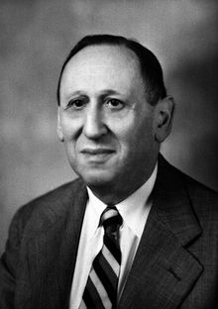
ASDs have sex-biased prevalence
2.6
1.4
3.1
16.0
1.3
2.3
2.7
4.7
4.1
2.5
2.3
3.7
2.7
2.1
2.0
2.6
1.8
6.6
3.5
2.1
5.0
15.7
4.1
2.2
8.0
4.2
3.3
4.2
4.5
3.8
2.5
5.7
3.0
8.3
2.9
~4:1 males:females have an ASD diagnosis
8:3 M:F in Leo Kanner’s original cases, 1943
Male bias consistent over time, geographic space
Male bias varies by intellectual ability
  High-functioning, M:F as high as 8:1
  Intellectual disability, M:F as low as 1.2:1
http://en.wikipedia.org/wiki/Leo_Kanner
Fombonne, Pediatric Research, 2009

Slide 14
Why study the sex bias in autism?
Are males at increased risk for autism?
  What is this male-specific risk factor?
  How can we reduce this risk?
Are females protected from autism?
  What is it that protects females?
  Can we use it to develop treatments?
  or
  Why are females not getting diagnosed?
  How can we identify and help them?
Notes:
There are undeniable biological differences between the sexes, and my research focuses on the potential role(s) for these factors in ASD risk
Others are working on the diagnosis issue, and that is incredibly important as well

Slide 15

Female protective model
Also known as multiple-threshold liability model
Prediction:
Autistic females carry greater genetic liability than autistic males, on average
Notes:
MOST basic conceptualization of this interaction is illustrated by the multiple threshold liability model
Bell curve like any trait, e.g. height - most people carry an average amount of risk-increasing variants in their genome, few carry very little, few carry a lot
Under model, females can withstand greater "mutation load" than males, for currently unknown reasons
Not that females escape carrying risk-increasing variants, but that they do not have as much of an impact on their neurodevelopment
Analogy = everyone carries a backpack, x-axis is more and more bricks
Females' protection = issued wheeled backpacks, instead of straps
Model makes a key prediction that we should be able to validate experimentally, if it is true = among affected individuals, females should carry greater liability than affected males

Slide 16
Risk is higher in siblings of autistic females
In two, European, population-based twin cohorts:
?
Z-score for quantified autistic traits
?
Robinson et al...Ronald, PNAS, 2013
Notes:
ALSO if autistic females' genetic risk is greater, then they should share this high risk with their siblings
Colors - note they are swapped from what you would expect
Bar plot - used quantitative scale of autism-related symptoms (Y-axis)

Slide 17
Risk is higher in siblings of autistic females
In high-risk families = 2 or more autistic children:
?
?
Notes:
Work that we have done has looked for this phenomenon in high-risk families
1) Risk differs by sex, higher in males (expected)
- Define MO families and FC families
2) Risk higher in FC families
3) Risk highest to boys in those FC families

Slide 18
Risk is higher in co-twins of autistic females
Monozygotic twins
Dizygotic twins
Notes:
MZ twins --> very high concordance. Sex difference not significant.
DZ twins --> higher concordance for FC twin pairs than MO
Of the 62 discordant M-F pairs, 56 have affected male, 6 have affected female

Slide 19
ASD risk increased with short interbirth intervals
California Department of Developmental Services registry
13,533 families with an autistic child, 20,981 control families
Risch et al, American Journal of Psychiatry, 2014
Notes:
Interesting finding, will show you how related to male/female differences in risk next
Large population cohort, finds that short IBIs associated with increased ASD risk

Slide 20
Males’ risk increased with short interbirth intervals
High risk families from AGRE:
?
?
Risch et al, American Journal of Psychiatry, 2014
In these high-risk families:
Females’ risk more strongly driven by their high mutation load
Males may be more vulnerable to (females protected from) environmental risk factors
Notes:
We looked for this phenomenon in our data, and found significant relationship between IBI and risk ONLY in males
1) Males overall show stronger relationship btwn IBI and risk
2) FC risk higher BUT only MO risk significantly related to IBI
3) Break down by sex and family type, see that IBI effect is driven entirely by males from families WITHOUT affected females
Families with high mutation loads (FC) more likely to have their ASD caused by these genetic factors, than caused or exacerbated by environmental circumstances

Slide 21
Autistic females carry higher mutation loads than males
Copy number variants:
Deletion
Duplication
Higher de novo CNV frequency in females
CNVs affect more genes in females
Levy, et al., Neuron, 2011
Sanders, et al., Neuron, 2011
Notes:
Have seen risk trends that agree with model that females need a bigger hit or load, but what about at the actual genetic level?
Many non-significant trends early on
CNV - one of first types of mutation to be associated with risk for autism
CNVs more FREQUENT in autistic females
ALSO hit MORE GENES in autistic females

Slide 22
Autistic females carry higher mutation loads than males
Single nucleotide variants:
Higher incidence of de novo, protein-damaging SNVs in autistic females
Substitution
Nonsense
STOP
Insertion
(or deletion)
Sanders, et al., Nature, 2012
Iossifov, et al., Neuron, 2012
Neale, et al., Nature, 2012
Notes:
Now, single-nucleotide variants (like introduced before, from exome sequencing)
Trends toward significance in small samples (State lab, Wigler lab, Neale/Daly lab)

Slide 23
Autistic females carry higher mutation loads than males
Higher CNV frequency in autistic females
Large, inherited CNVs more likely inherited from mother than father
Neurodevelopmental conditions:
Autism spectrum:
Jacquemont, et al., American Journal of Psychiatry, 2014
Notes:
Trends toward significance in small samples (State lab, Wigler lab, Neale/Daly lab)
Earlier this year, a study out of UW was able to find statistically significant differences between males and females in their mutation loads
Table - NOTE the percentages - greater proportion of female cases have large CNVs
If they were inherited, BIG CNVs more likely came from mother
Y-axis is ratio of maternal:paternal transmissions
Makes sense, if females are protected - moms can carry

Slide 24
Females are protected from autism
Females with autism more likely to carry large mutation loads than autistic males
At the population level, autistic females share this high genetic risk with their siblings
?
Mothers may carry and pass down risk-increasing variants
Notes:
Summary slide for section 2

Slide 25
Females are protected from autism
Which factors are involved? How do they work?
Notes:
Now, we can start thinking - what other factors are involved in ASD risk that could shift males closer to threshold for being affected?
...could shift females away from this threshold?

Slide 26
Outline
Recent advances in autism genetics research
http://www.scientificamerican.com/article/autism-genetic-mutations/
What genetics & family data show us about risk to females vs. males
Proposed mechanisms for females’ protection, males’ risk

Slide 27
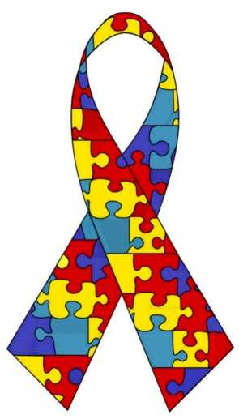
Risk for Autism Spectrum Disorder is:
Genetic
Sex-biased
ASD
Notes:
BOTH factors are major contributors to ASD biology, my work is focused on their interaction
If we could understand the intX, we would know something fundamental about ASD pathophysiology

Slide 28
Hypothesized mechanisms & theories
Hypothesis | Males | Females
X-linked condition | X_{m}Y = 1 X | X_{p}X_{m} = 2 Xs
X chr carries protective genes, imprinted & paternally expressed | X_{m}Y = NO paternal X | X_{p}X_{m} = has paternal X
Extreme male brain theory | T exposure, prenatally | Little/no T exposure prenatally
Camouflaging behavior | Less likely to learn and apply social skills that mask ASD symptoms | More likely to learn and apply social skills that mask ASD symptoms
Notes:
- X-linked = caused by genes on X chromosome, females have 2 copies, males only 1, females' 2nd copy can often compensate
- Imprinting = 2 copies of every gene, but only 1 copy is used
- EMB = cognitive-behavioral theory, attached to a very general biological hypothesis
- Camouflage = behavior & its effects on diagnosis
ALL INCOMPLETE (say why)
But, interesting recent evidence for Extreme Male Brain

Slide 29
Prenatal testosterone exposure
Extreme Male Brain Theory:
Fetal testosterone correlates with Autism Quotient scores
Empathizing
Systemizing
Auyeung, et al., British Journal of Psychiatry, 2009
Baron-Cohen, Trends in Cognitive Science, 2002
Notes:
EMB: Cognitive profile on 2 dimensions
Previously - Baron-Cohen group observed correlation btwn fetal T levels and later cognitive profiles

Slide 30
Prenatal testosterone exposure
Extreme Male Brain Theory:
Fetal testosterone levels are elevated in males who are later diagnosed with ASD
Empathizing
Systemizing
Baron-Cohen, et al., Molecular Psychiatry, 2014
Baron-Cohen, Trends in Cognitive Science, 2002
Notes:
RECENTLY - took this work a step farther to see how fetal T levels related to ASD diagnosis later in life
Used population registry data and amniotic fluid samples from state-run biobank to find - T (on average) is elevated in individuals with autism spectrum conditions

Slide 31
Prenatal testosterone exposure
Fetal testosterone levels are elevated in males who are later diagnosed with ASD
Baron-Cohen, et al., Molecular Psychiatry, 2014
Notes:
But, not specific to T - other hormones in same biosynthetic pathway were similarly affected

Slide 32
Hypothesized mechanisms & theories
Hypothesis | Males | Females
X-linked condition | X_{m}Y = 1 X | X_{p}X_{m} = 2 Xs
X chr carries protective genes, imprinted & paternally expressed | X_{m}Y = NO paternal X | X_{p}X_{m} = has paternal X
Extreme male brain theory | T exposure, prenatally | Little/no T exposure prenatally
Camouflaging behavior | Less likely to learn and apply social skills that mask ASD symptoms | More likely to learn and apply social skills that mask ASD symptoms
Brain regions affected in ASD are different between males and females in a typical brain
How do male and female brains differ?
Can these differences tell us anything about risk for/protection from autism?
Notes:
Broad, conceptual possibility that is not mutually exclusive with other theories is...
- Brain regions affected are different between males & females, such that risk-increasing mutations have different effects in male & female brain
>>To understand sex biased prevalence, must understand how ASD risk genes fit into molecular pathways governing sexual dimorphism of the brain<<

Slide 33

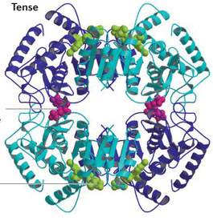
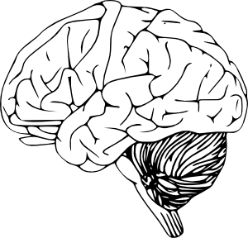
Sex differences in gene expression levels
What is gene expression?
DNA
Genes
RNA
Gene transcripts
Protein
Functional activity
Tissue = Brain
Cells → Networks → behavior
Notes:
Gene expression is the amount of transcript made from a gene = how that gene is used.
We measure expression by measuring the amount of RNA coming from different genes
----- Meeting Notes (9/30/14 16:08) -----
We have used gene expression to evaluate differences between male and female brains
DNA - where information is stored, like a library
RNA - copies of genes that are taken out into cell, like a book
Protein - what is built from instructions in the RNA molecules
Tissue/Brain - how the brain operates depends on the proteins produced
Expression = measurement of RNA transcripts, tells us which genes are being used and in what quantities

Slide 34

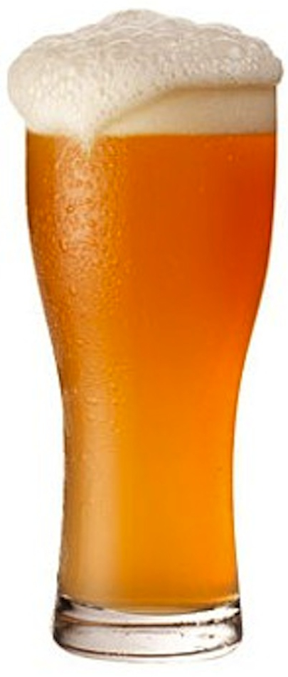

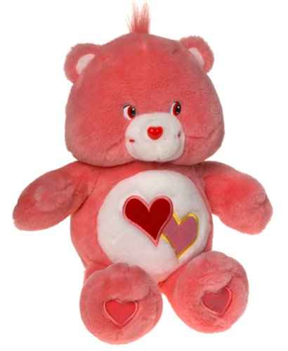
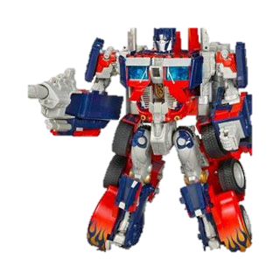

Sex differences in gene expression levels
What is differential expression?
Gene regulation
DNA
Genes
RNA
Gene transcripts
Protein
Functional activity
Tissue = Brain
Cells → Networks → behavior
Gene expression can differ by:
Sex
Time
Cell or tissue type
Brain region
...etc
Notes:
Differential expression = comparison of gene expression levels between points of interest:
- Males & females
- Between brain regions
- Between cell types
- Across time
- Between patients with & without a condition
...etc

Slide 35
How do sex differential gene expression levels relate to autism risk genes?
Hypotheses
ASD risk genes themselves are expressed at different levels in male & female brain
or
2. ASD risk genes interact with other processes that differ between the male and female brain

Slide 36

Kang, et al., Nature, 2011
Notes:
Bspan adult = 13-40 years, N=5 males, 5 females
Bspan prenatal = 16-22 PCW, N=4 males, 4 females
Ran sex-differential expression analysis between males and females at the adult and the prenatal stages
Goal is to find sets of genes expressed at higher level in males, or higher level in females

Slide 37
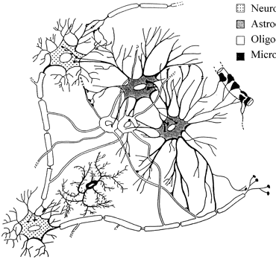
Are autism risk genes or pathways expressed differently by sex?
Over-representation analysis
Reference gene sets for annotation
Hypothesis 1: Known ASD risk genes
2-sided Fisher’s exact test
Is this overlap…
- More genes than expected? Enrichment
- Fewer genes than expected? Depletion
Hypothesis 2: ASD-associated expression patterns & cell type markers
Reference gene set
Sex-DE genes
Background gene set
Baumann & Pham-Dinh, Physiological Reviews, 2001
Notes:
How do we make sense of these lists of DE genes? See if they fall into functional categories
Hyp 2 - use genes from study of expression in ASD brain

Slide 38
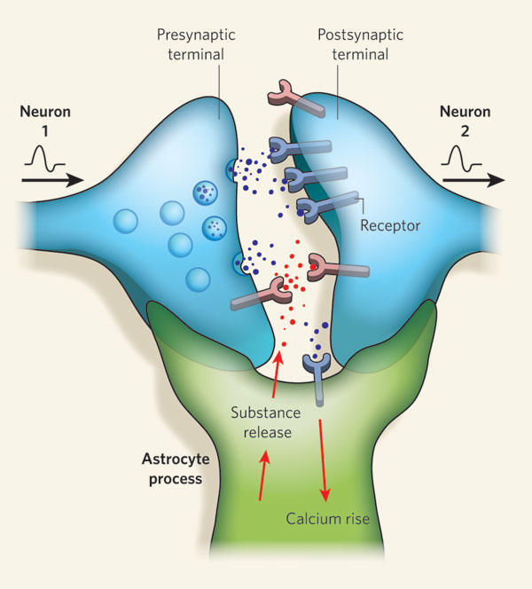
Genes differentially expressed by sex in adult cortex are:
Not enriched for known ASD risk genes
Enriched for ASD-associated pathways and cell markers
Synapse
Neuron 1
Neuron 2
Neuron
Astrocyte (glial cell)
Synapse
Astrocyte
Allen & Barres, Nature, 2009
Notes:
Each box represents what we find in the center of a Venn diagram
Red = enrichment, "hot"
Blue = depletion, "cool"
No enrichments for sets of risk genes
BUT, see some enrichments for other sets of genes – ASD expression patterns & cell type
Esp enrichment for astrocyte markers for genes up in females
Many ASD risk genes function at the synapse
Astrocytes are not neurons, but are also involved in synapse function, modulating neurotransmitter levels, cleaning up synapses that are no longer needed, etc

Slide 39
Genes differentially expressed by sex in prenatal cortex are:
Not enriched for known ASD risk genes
Depleted of FMRP target genes
Male-up genes are enriched for ASD-up gene sets
and astrocyte markers
Notes:
See very similar patterns in prenatal brain

Slide 40
Genes differentially expressed by sex in adult cortex are:
Not enriched for known ASD risk genes
Enriched for ASD-associated pathways and cell markers
Notes:
Back to adult – especially interested in this overlap with ASD vs. CON expression patterns

Slide 41
Sex-DE genes in ASD-associated modules are:
Up-regulated in males and in ASD cortex
Male
ASD
M16 module
ASD
CON
Fold difference
Female
CON
Up-regulated in females and in controls’ cortex
Male
ASD
M12 module
ASD
CON
Fold difference
Female
CON
Voineagu, et al., Nature, 2011
Notes:
M16 is a module from Voineagu study, up-regulated in ASD cortex, enriched for immune response, inflammatory signal, glial function
M12 is a module from Voineagu study, down-regulated in ASD cortex, enriched for synaptic function, also enriched for subthreshold GWAS association signal.
For M16 and M12 genes, see striking agreement in exp. direction with the ASD DE
Emphasize - all need to know is that the plotted bars are going in the same direction

Slide 42
Independent data sets show that M16 module genes are expressed at higher levels in males
All sex-DE genes with FD≥1.2 in both BrainSpan & replication samples
(N = 122 genes)
Male,
data set #2
Female, data set #2
Female, data set #1
Male,
data set #1
Notes:
Replicated this finding in a second data set, see very similar patterns esp for M16 module genes
M16 module is enriched for genes expressed in glia, for functions related to the immune system (which acts through glia in the brain)
M16 and astrocyte enrichments with genes up in males suggest that glia are involved in sexual dimorphism of the brain
...and therefore may be involved sex-differential ASD risk

Slide 43
Glial cells may play a role in the mechanisms driving sex-biased risk for autism
Known ASD risk genes are not differentially expressed by sex in adult or prenatal cortex
“Male-up” genes are enriched for:
  Glial/astrocyte markers
  Gene sets expressed at higher levels in ASD cortex
Genes that are differentially expressed by both sex and in ASD suggest a role for sexually dimorphic neuron-glial interactions in ASD risk
Notes:
...Astrocytes (in some regions of the brain) have been shown to respond to steroid hormone exposure
This mechanism is far from definite, though these findings suggest this possibility
Much work is needed to determine if this is true
Why care about this potential mechanism? If there are 100s of genes involved in risk, and most act at the synapse, or in neurons, glial cells may provide a target for broadly acting Rx's that can help patients with many different causal genetic variants

Slide 44
Summary
Genetics research has made substantial advances which aim to improve diagnoses and treatment development for autism
http://www.scientificamerican.com/article/autism-genetic-mutations/
Females are protected from genetic, and possibly environmental, risk factors
Biological factors that protect females or (increase males’ risk) may involve early hormone exposure and/or glial cell function in brain
Notes:
...stay tuned!

Slide 45

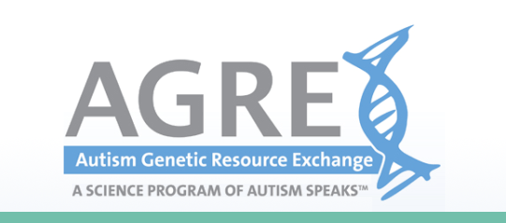
Acknowledgements
Mentors & colleagues
Dan Geschwind
Rita Cantor
Art Arnold
Nelson Freimer
Jenni Lowe
Neelroop Parikshak
Data sources
AGRE
BrainSpan
Funding
NIMH:
  ACE Network,
  R01MH081754
  ACE Center, 3P50 HD055784
  Ruth L. Kirschstein NRSA, F31 MH093086
ARCS Foundation
UCLA Graduate Division

